Slide 1
Predicting Future Offensive Performance of Major League Baseball Players
Group Members’ Names
School Name

Slide 2
INTRODUCTION
1. State your question of interest
there is increased demand of players by baseball clubs hence the need to produce a model that will predict their performance. The model will help clubs predict how their players will perform based on their current status.
2. State your hypotheses
There is linear relationship between weight on-base average and other independent variables.
3. Is there background information that your audience should be familiar with?
statistical analysis have been used in predicting performance of players since publication of Moneyball book in 2003. This replaced traditional methods of predicting player performance such as batting average and win/loss record with new and more accurate method known as weighted on-base average. This method gives credit to a player based on what he or she is responsible for.

Slide 3
METHODS
How was the data collected?
The data used for the analysis was gathered from secondary data sources. The data was collected from observational study.
Describe the participants in the study.
The data comprised of 176 players of major baseball league. All players had at least 400 appearances and above 18 years.

Slide 4
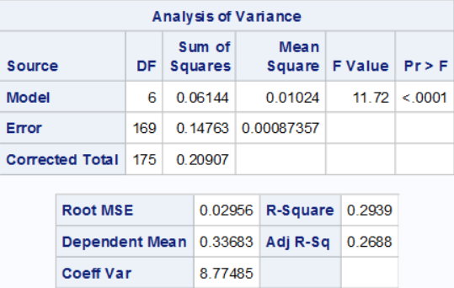
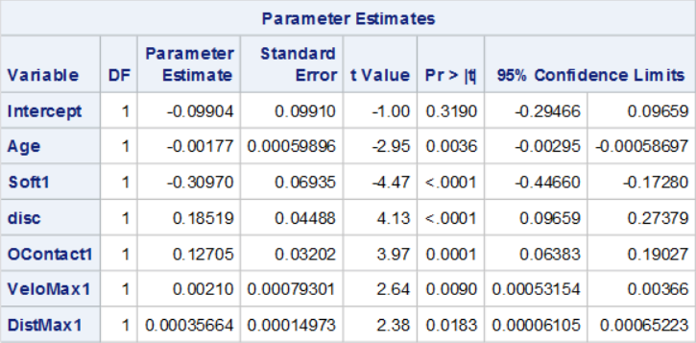
RESULTS
Provide inferential (t-test, and/or correlational, and/or F-test results) statistics.
Explicitly state whether or not your hypothesis was supported
the results showed that there is linear relationship between the variables and WoBA. However, the variable speed was dropped since it did not show significant relationship.

Slide 5
DISCUSSION
Limitations
  There is need to use a larger sample size in order to reduce the sampling error. Also I would have used more diversified data to include all players.
Implications
  The analysis showed that predicting performance of a player is very important subject in baseball. This would assist clubs sign players who are likely to win trophies.
  Results imply that as players age increase his or her performance reduces. Also, players that make more runs perform better than players that make minimal runs.
Ask your audience if they have questions about your project

